Slide 1
Project Presentation of CO-OP Project at Industry (Module-2) (22CS421)
On
Automating Manual Business Workflows in SaaS Products: A Rule-Based and Event-Driven Framework
Chahat (2210990231) | Bhomya Sharma (2210990224)
Prerana Thakur (2210992085) | Noovi Bedi (2210992004)
Supervised By
Mr. Ashish Kumar
Department of Computer Science and Engineering,
Chitkara University, Punjab

Slide 2
Introduction
SaaS platforms grow faster than the processes supporting them
Manual tasks: routing requests, chasing approvals, generating reports, syncing data
Manual workflows cause bottlenecks, errors, and cascading failures as scale increases
The Problem
Repetitive manual tasks slow down platform growth
Existing tools (BPM, RPA, Zapier, n8n) have critical gaps for SaaS workflows
No single framework combines rule-based control + event-driven execution for SaaS
4

Slide 3
Related Work & Background
Prior Research Highlights
Georgakopoulos et al. (1995): Foundational workflow management systems concepts
Systematic review (2016-2023): 300+ papers — RPA, WMS, ERP dominant in industry
Agostinelli et al. (2020): Process mining + automation scripting for self-improving RPA
Tavares et al. (2023): RPA-BPM hybrid — 5-stage lifecycle: Design, Model, Execute, Monitor, Optimize
Event-Driven Architecture Advantage
Chavan (2021): EDA microservices are 19% faster and have 34% fewer errors than API-based ones
Li et al. (2009): Multi-tenant SaaS workflows — dynamic task assignment remains an open problem
5

Slide 4
Comparative Analysis of Existing Tools
Tool Comparison Overview
Zapier: No-code trigger-action; no conditional logic, no failure policy, vendor lock-in
n8n: Open-source visual canvas; flexible but lacks built-in monitoring & rollback
Microsoft Power Automate: Deep Microsoft 365 integration; overkill/expensive for SaaS startups
Apache Airflow: Excellent for data pipelines; no business rules, no event-driven triggers
Key Gaps in All Existing Tools
None combine: formal rule model + event-driven execution + SaaS-native design
None provide built-in TET / EFR / MDI performance monitoring out of the box
None are fully vendor-neutral, open, and lightweight for SaaS from the ground up
6

Slide 5
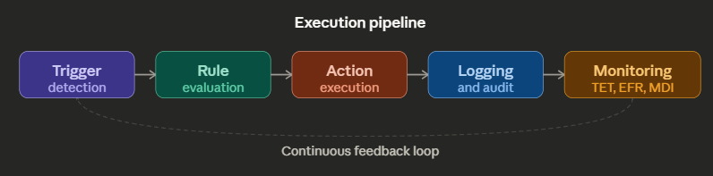
Proposed Framework Architecture
Five-Component Architecture
Workflow Trigger Engine — detects system events and fires automation
Rule Evaluation Module — evaluates conditions against system state (JSON/YAML rules)
Playbook Execution Engine — runs action sequences with branching and rollback
Integration Layer — REST APIs, webhooks, event listeners; fully vendor-neutral
Monitoring & Feedback Module — real-time TET, EFR, MDI and throughput tracking
7

Slide 6
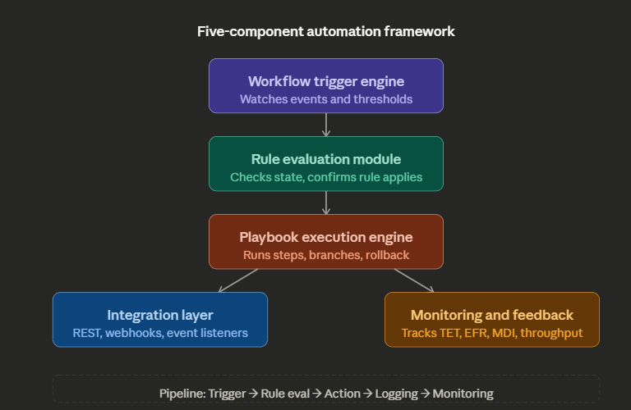
Proposed Framework Architecture

Slide 7
Proposed Framework Architecture
Design Principles
Stack-agnostic, horizontally scalable, asynchronous message passing
Portable YAML/JSON rules with version control support
Modular components — each can be replaced independently

Slide 8
Formal Rule Model & Metrics
Rule Definition: R = { TC, EC, AM, EP, FP }
TC (Trigger Condition): System event or threshold that activates the rule
EC (Evaluation Criteria): Logical check — is the rule applicable to current state?
AM (Action Mapping): Ordered sequence of steps to execute
EP (Execution Priority): Rank when multiple rules fire simultaneously
FP (Failure Policy): Retry / Skip / Rollback on failure
Performance Metrics Defined
TET (Task Execution Time): TET = T_complete − T_trigger
EFR (Error Frequency Rate): EFR = N_failed / N_total × 100%
MDI (Manual Dependency Index): MDI = S_manual / S_total × 100%
8

Slide 9
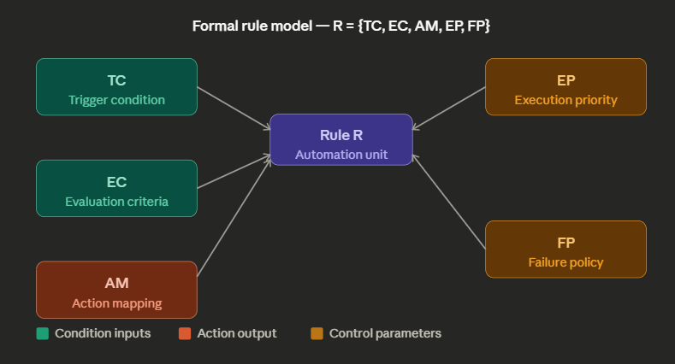
Formal Rule Model & Metrics

Slide 10
Case Study: Enterprise SaaS Onboarding
Manual Baseline (Before Automation)
New enterprise account registration triggers a chain of manual handoffs
Sales engineer manually creates CRM record
Ops team sends welcome email and provisioning details
Engineering ticket filed manually; CSM schedules check-in
Each manual step risks delay — late provisioning ticket delays client activation by days
Automated Framework in Action
Step 1: REST API call auto-creates CRM record from registration event payload
Step 2: Integration Layer fires webhook — personalised welcome email dispatched
Step 3: Engineering ticket auto-created; 48hr CSM check-in auto-scheduled
Result: TET drops from hours to under 3 minutes; MDI falls below 20%
9

Slide 11
Implementation Details
Rule Configuration (JSON Example — CRM Step)
rule_id: "onboard-enterprise-crm"
trigger: event = "account.registered" from registration_service
eval_criteria: account_type = "enterprise", region in [IN, US, GB]
action: POST to CRM API using enterprise_onboarding_v2 playbook
failure_policy: retry (max 3, 60s delay) → alert ops-team on exhaustion
Orchestration Loop Logic
Blocking queue consume() → rule_engine.evaluate(event) → sort_by_priority()
playbook_engine.execute() with inline TET recording per rule
On ExecutionError: record EFR, apply failure policy (retry/skip/rollback)
Integration: inbound webhooks → normalize to internal schema → orchestration loop
10

Slide 12
Performance Evaluation Results
Simulation Setup
100 workflow instances across 10 categories of repetitive SaaS workflows
30 automation rules (~3 rules/category); standard load + 2× elevated load tested
Manual baseline: average task time ~42 min end-to-end, EFR 20-25%
Results vs. Manual Baseline
Task Execution Time: 42 min → 8-14 min (68-82% reduction)
Error Frequency Rate: 20-25% → 5-8% (3-4× improvement)
Throughput: 20 tasks/hr → 60+ tasks/hr (3× increase)
Load Degradation at 2× volume: Manual 35% → Automated <12%
Manual Dependency Index: ~78% → <15% (85% reduction in human steps)
11

Slide 13
Discussion & Limitations
Key Insights from Results
EFR improvement (20-25% → 5-8%) is the most impactful finding
A failed approval step can block 3+ downstream processes in enterprise SaaS
Asynchronous execution explains <12% degradation at 2× load — distributes work naturally
MDI <15% means most workflows run fully automated — humans only for true edge cases
Honest Limitations
Simulation only — no production deployment; real-world edge cases not captured
Rule module cannot handle unanticipated scenarios not modelled at rule-write time
Multi-tenant isolation not tested (open problem per Li et al.)
No direct benchmark against Zapier / Power Automate / Airflow on same workflows
12

Slide 14
Future Work & Conclusion
Future Directions
ML-based rule generation via process mining on historical execution logs
Multi-tenant concurrent load testing to validate production readiness
Head-to-head comparison with Zapier, Power Automate, Airflow on identical workflows
Anomaly detection + GDPR/SOC 2-compliant audit logging for finance & healthcare SaaS
Conclusion
Proposed a 5-component rule-based + event-driven automation framework for SaaS
Defined clear metrics: TET, EFR, MDI — validated through controlled simulation
Results exceeded expectations across all three metrics
Framework is conceptually solid and warrants further development and production testing
13

Slide 15
Thank You
15

